Slide 1
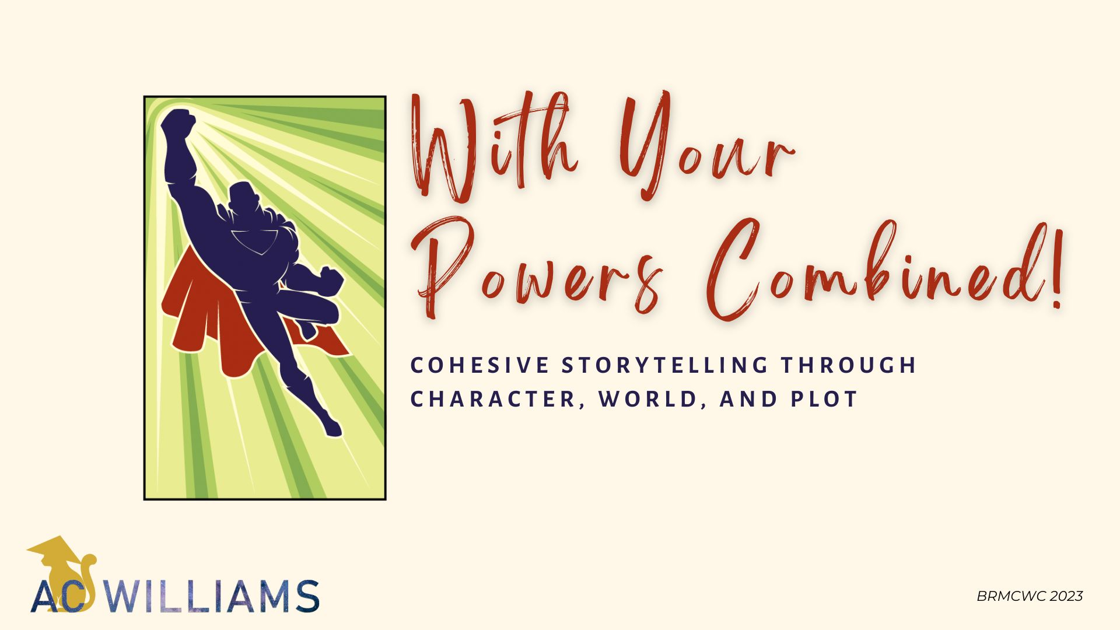

Slide 2
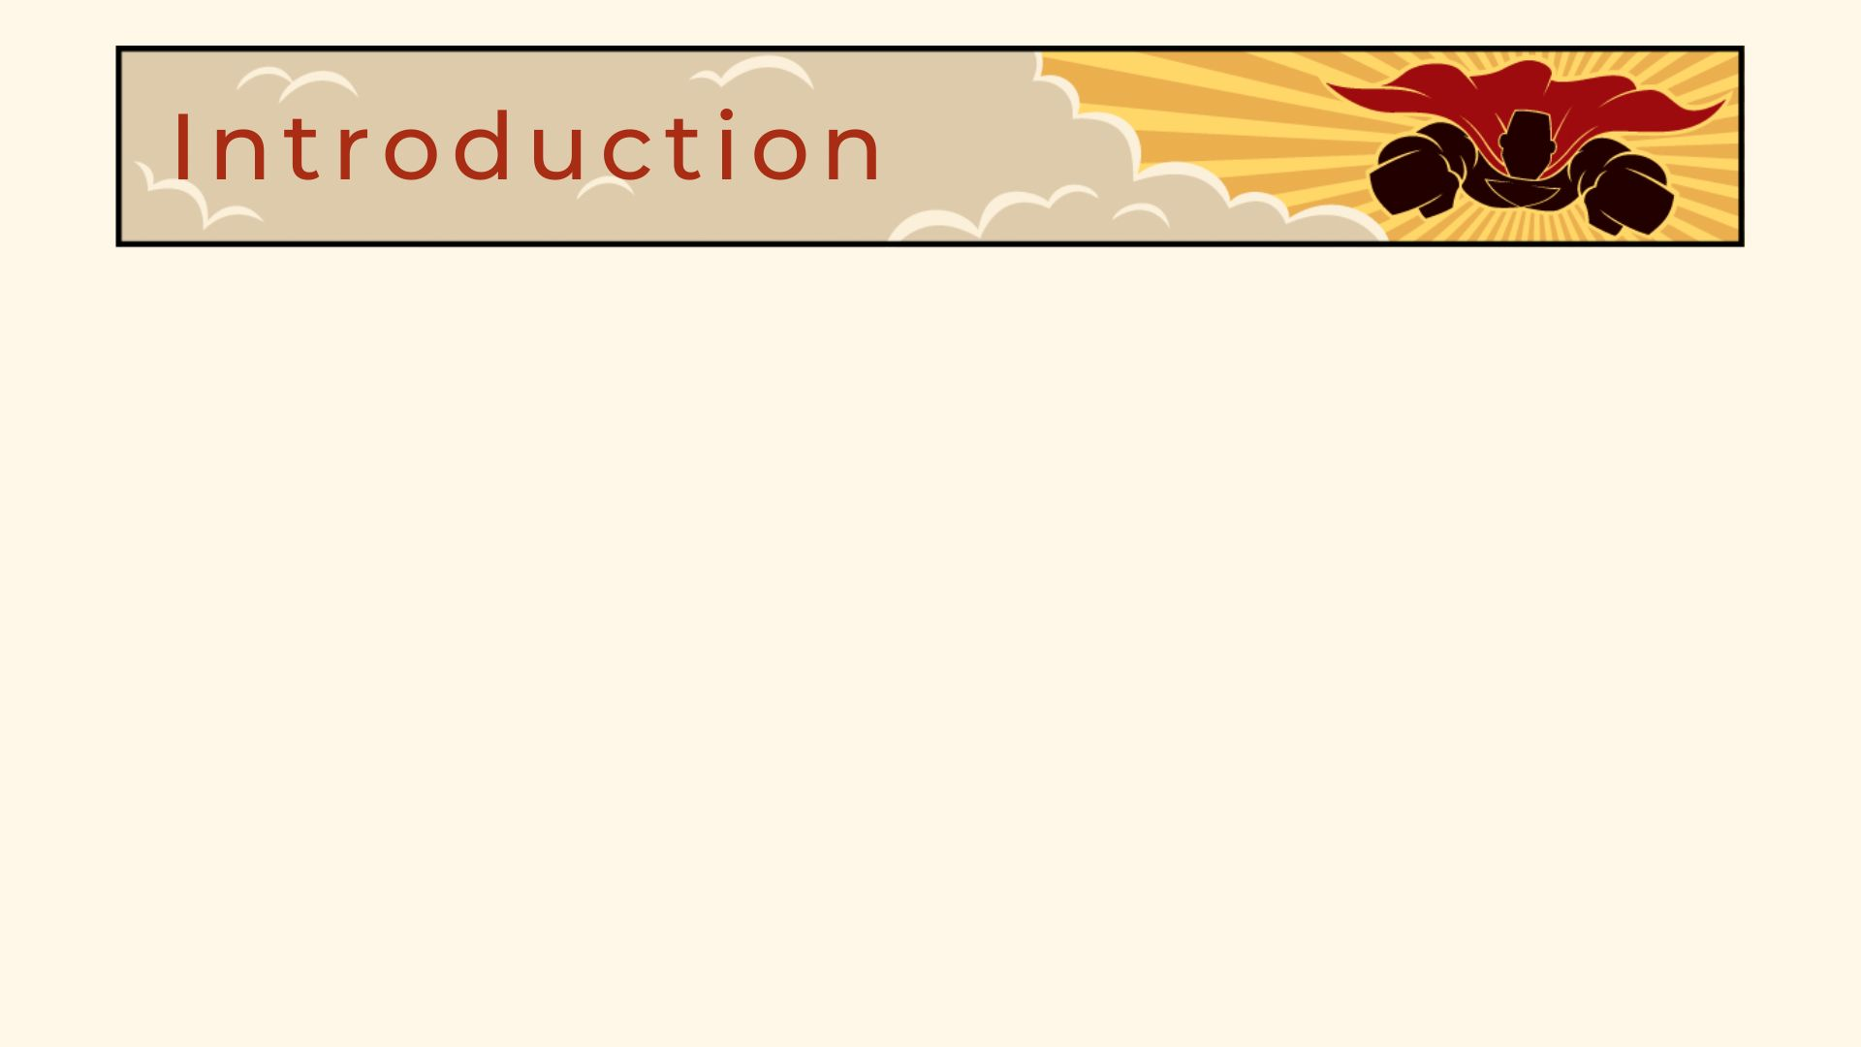
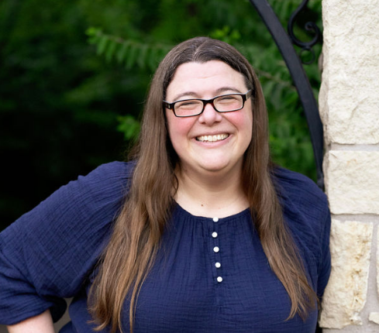
Author, Editor, Publisher, Coach
15 published books in fiction and non-fiction
Monthly contributor to two blogs ranked in Writer’s Digest Top 101 Sites for Authors
2022 Arise Daily Devotional Writer of the Year
Realm Award finalist and winner
Selah Award finalist

Slide 3

What is Cohesive Storytelling?
What is Plot?
Common Plot Structures
On the Importance of Inciting Incident, Climax, and
Real Resolutions
A Final Note on Writing Series

Slide 4

What is Cohesive Storytelling?

Slide 5

A House
Interior Design (Character)
Landscaping (World)
Structure (Plot)

Slide 6

CHARACTER
PLOT
STORY
WORLD

Slide 7
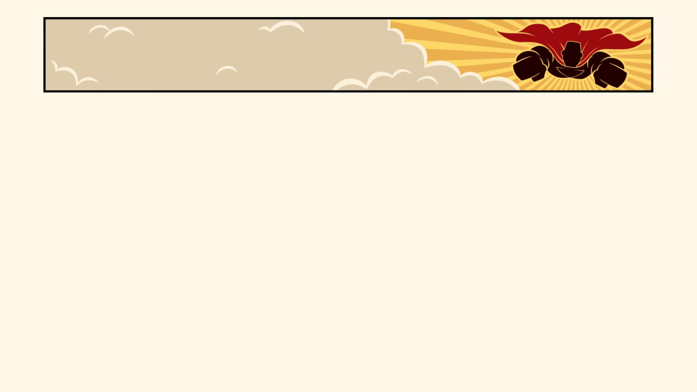


Two Steps to Character Work
IDENTITY
STRATEGY
Who They Are
What They Want

Slide 8
The Most Important Question
WHY?

Slide 9

The world you build should have a
MASSIVE INFLUENCE
on the characters who inhabit your stories.

Slide 10
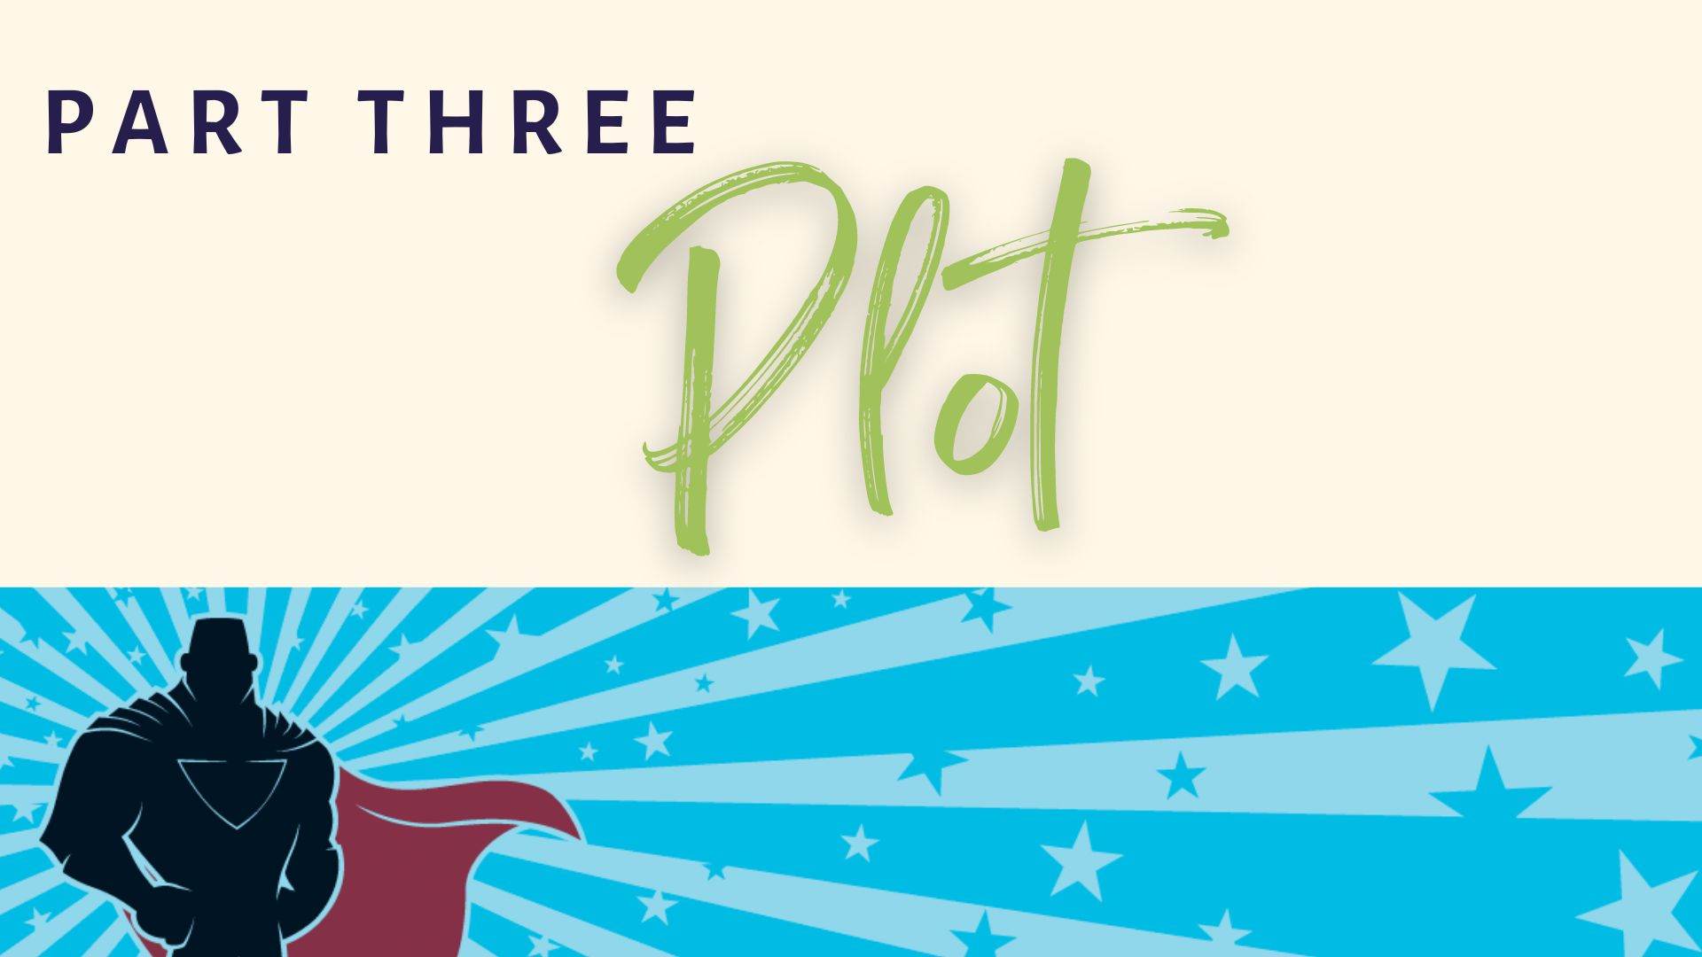

Slide 11
What Is Plot?
PLOT is the sequence of events that make up a story.
PLOT is story, one step at a time.
PLOT is what happens next.

Slide 12
What Is Plot?
In the terms of the CHARACTER ARC,
the plot is the external goal
that the character believes
will solve their problem.
It’s what they WANT.

Slide 13
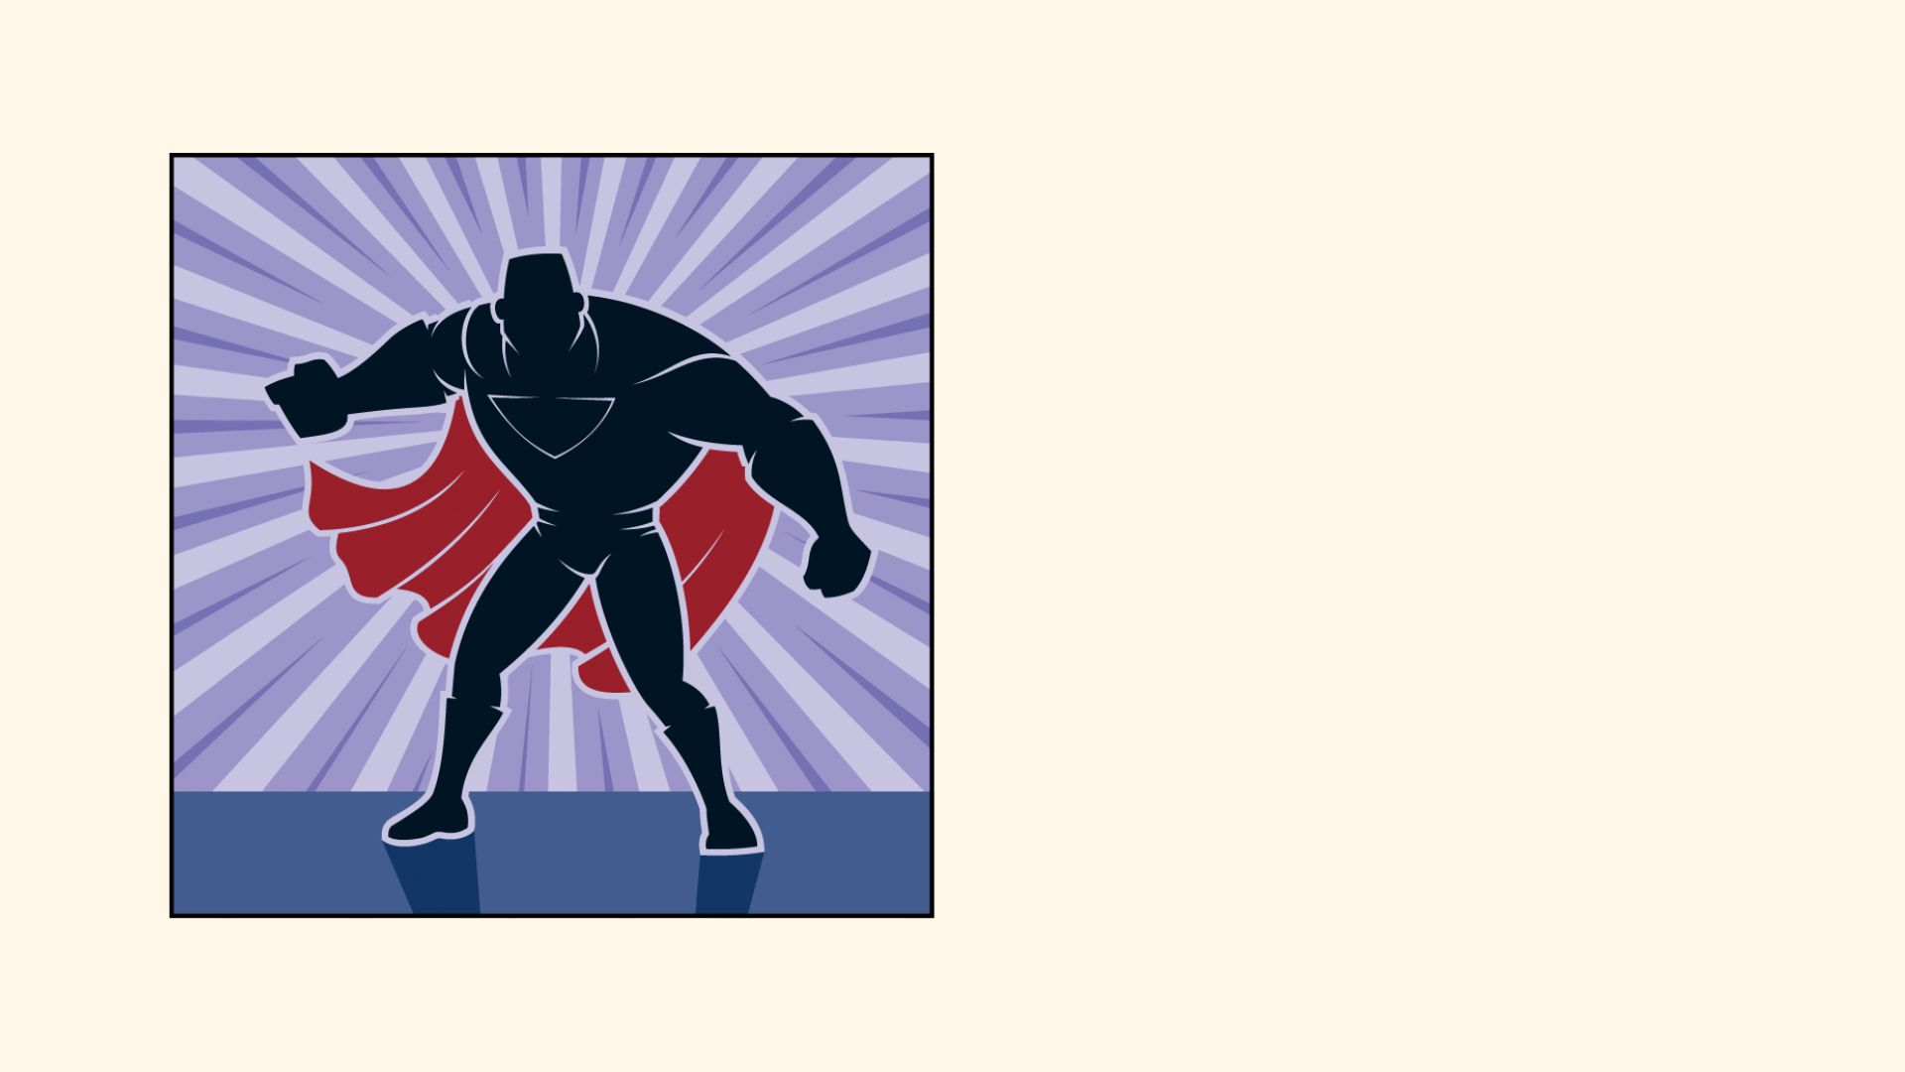
CONSIDER
Your Character Identity
(PC CHILIDOG)
Your Character Strategy
(Character Arc)
Your World
Now … What Happens?

Slide 14
Common(?) Plot Structures
The Three-Act Structure
The Five-Act Structure
The Seven-Act Structure
The A.C. Williams Structure

Slide 15
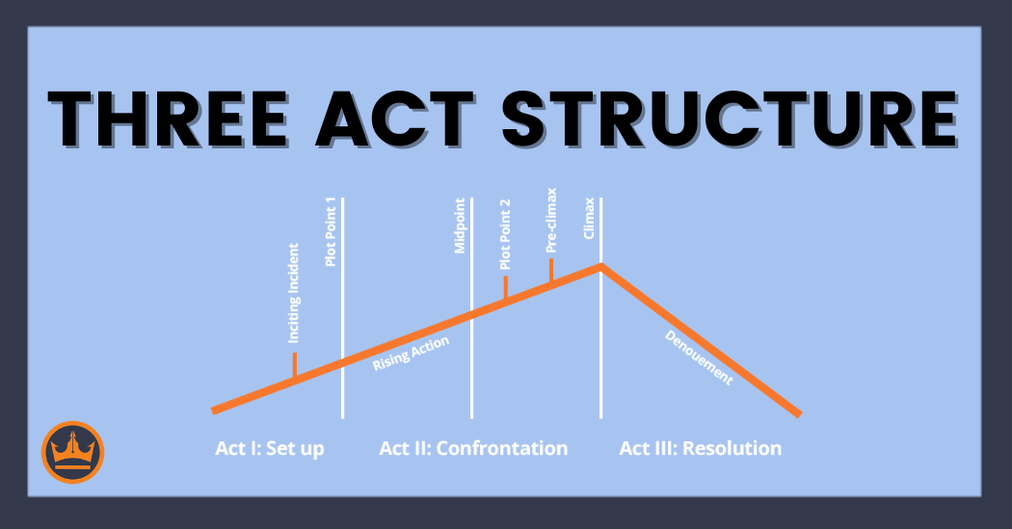
The Three-Act Structure
The SETUP | The CONFRONTATION | The RESOLUTION

Slide 16
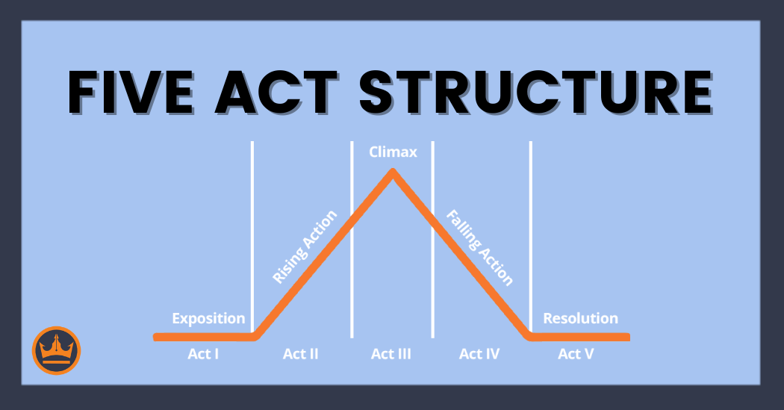
The Five-Act Structure
Exposition | Rising Action | Climax | Falling Action | Resolution

Slide 17
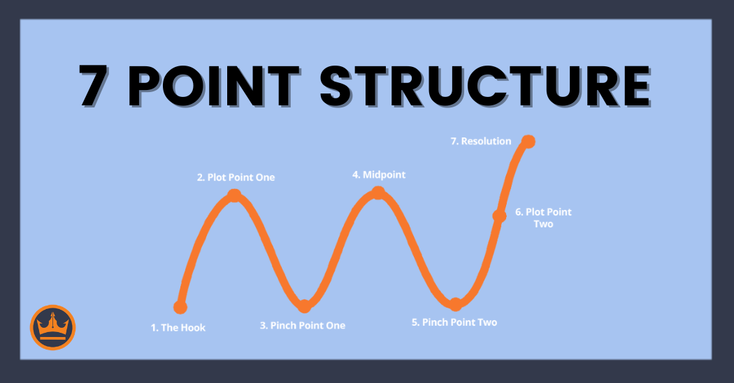
The Seven-Point Structure
Hook | Plot Point 1 | Pinch Point 1 | Midpoint
| Pinch Point 2 | Plot Point 2 | Resolution

Slide 18


The Chaotic-Squirrels Structure

Slide 19
The Structure I Prefer (for series)
Point a: Introduction (optional)
Point 1: Inciting Incident / Hook
Point 2: Complications
Point 3: Decision Point
Point 4: Worse Complications
Point 5: Crisis Point
Point 6: Nightmare Fuel
Point 7: Resolution
Point z: Sequel Setup (optional)

Slide 20
Important Points to Remember
The Inciting Incident
ONE Climax
An ACTUAL RESOLUTION

Slide 21
The Inciting Incident
PROTAGONIST must engage readers from
SENTENCE ONE.
Readers must understand the character’s
basic WANT immediately (or at least we
need a base sense of it, otherwise we won’t
care at all).

Slide 22
Write ONE Climax
Don’t try to fit so much into your story that
you leave too many loose ends.
Tell ONE STORY. Subplots are fine, but
make sure they aren’t more interesting than
your MAIN STORY.

Slide 23
Develop an Actual Ending!
MUST BE SATISFYING, even if it’s not happy
May not require death but MUST fit the type
of story you’re telling
Must connect to the WORLD
Must connect to the CHARACTER ARC
Notes:
ENDGAME

Slide 24
What About Series Writing?
Master writing standalones first
But if you MUST write a series, keep the
main thing the main thing:
    Setting up or introducing your series is
    always SECONDARY
    Never sacrifice book one for book two

Slide 25
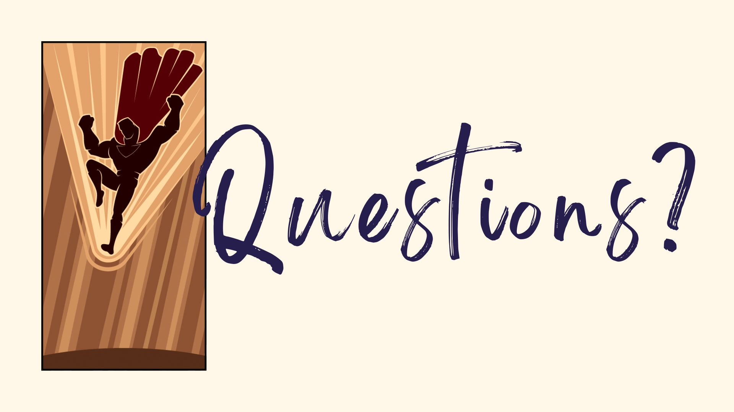

Slide 26
